Slide 1

SMART WASTE MANAGEMENT SYSTEM
INTERNET OF THINGS
PRESENTED BY
S.SUGANYA (230701351)
VARSHA THOMAS (230701372)
R.YASHVINTHINI (230701386)

Slide 2
3 | Abstract
4 | Introduction
5 | Objectives
6 | Literature review
7 | Existing System
8 | Proposed System
9 | Modules used
11 | Future Enhancements
12 | References
Agenda

Slide 3
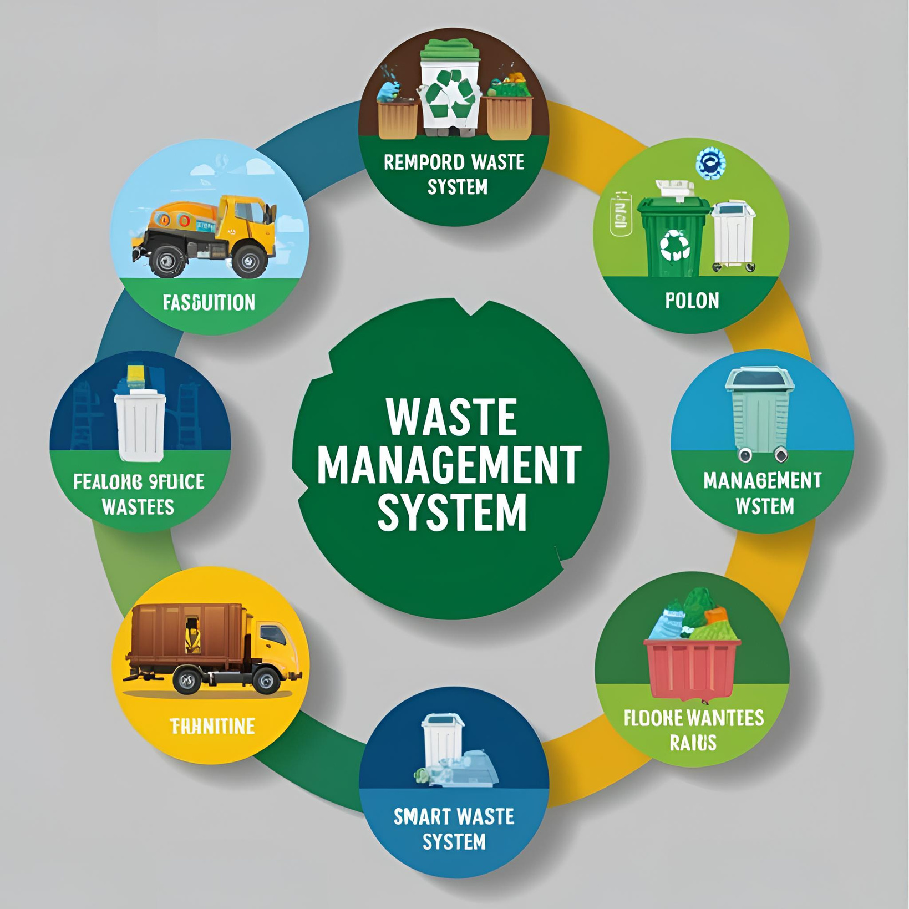
ABSTRACT
This project presents a Smart Waste Management System designed to improve urban waste collection through the use of IoT technology. Smart sensors placed in bins monitor waste levels and transmit real-time data to a central system. This data is used to optimize collection schedules and routes, reducing fuel usage, labor costs, and environmental impact. The system enhances efficiency, minimizes overflow issues, and supports sustainable urban living by integrating technology with traditional waste management practices.

Slide 4
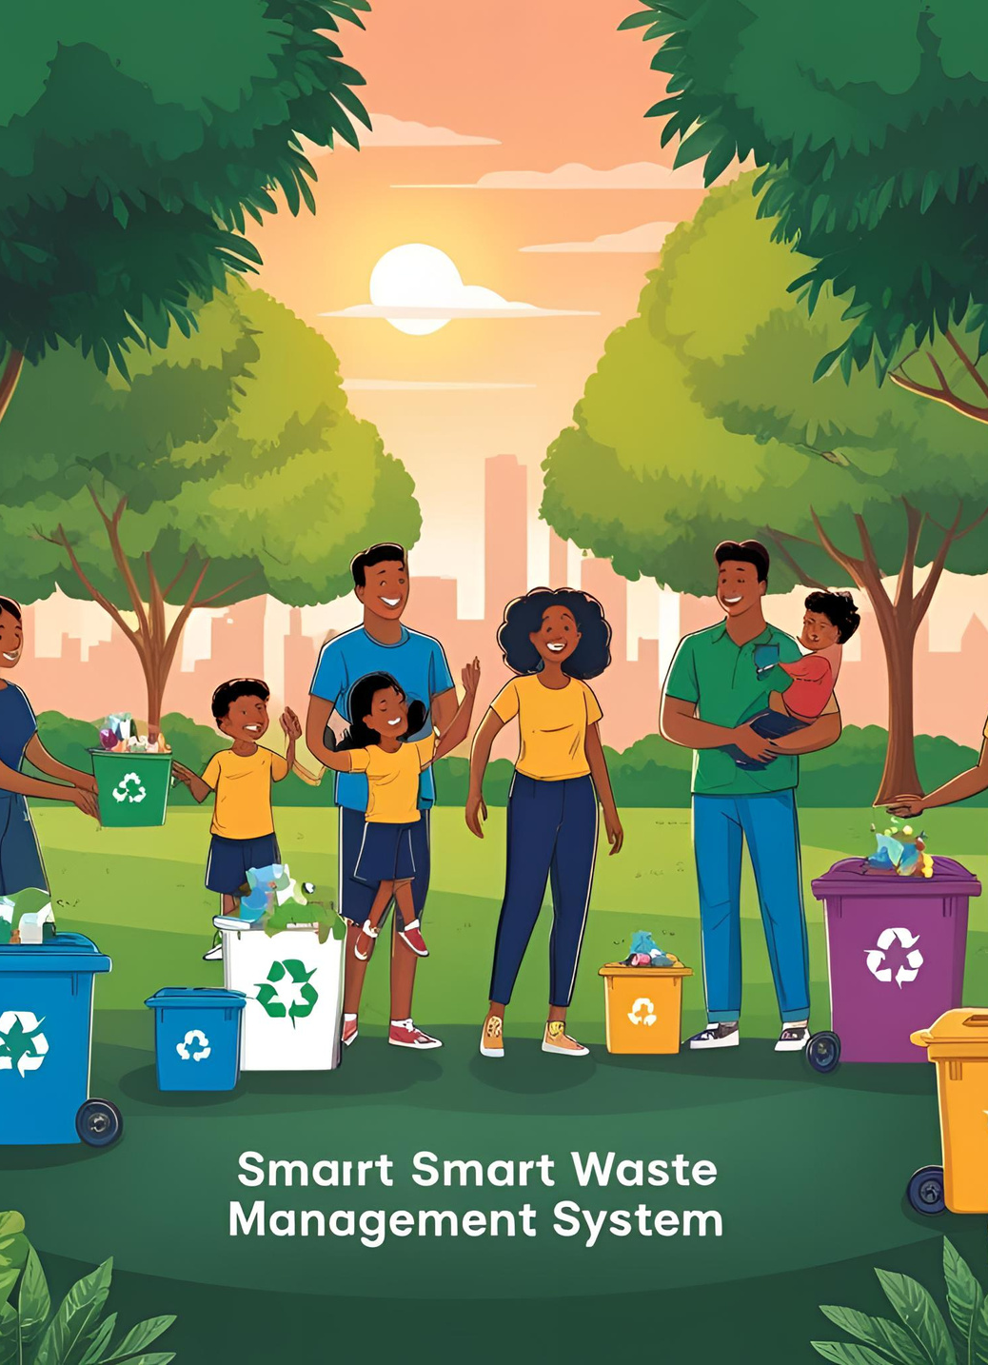
INTRODUCTION
Problem: Traditional waste collection is inefficient, often leading to overflowing bins and unnecessary trips.
Solution: An IoT-based system using ultrasonic sensors and ESP32 microcontrollers for real-time bin monitoring.
Key Features:
Bins send alerts when full
Optimized collection routes using GPS
Reduced environmental impact & operational cost
Public Involvement:
Mobile App for users to track bins and request pickups
Outcome: A smarter, cleaner, and more sustainable approach to urban waste management.

Slide 5
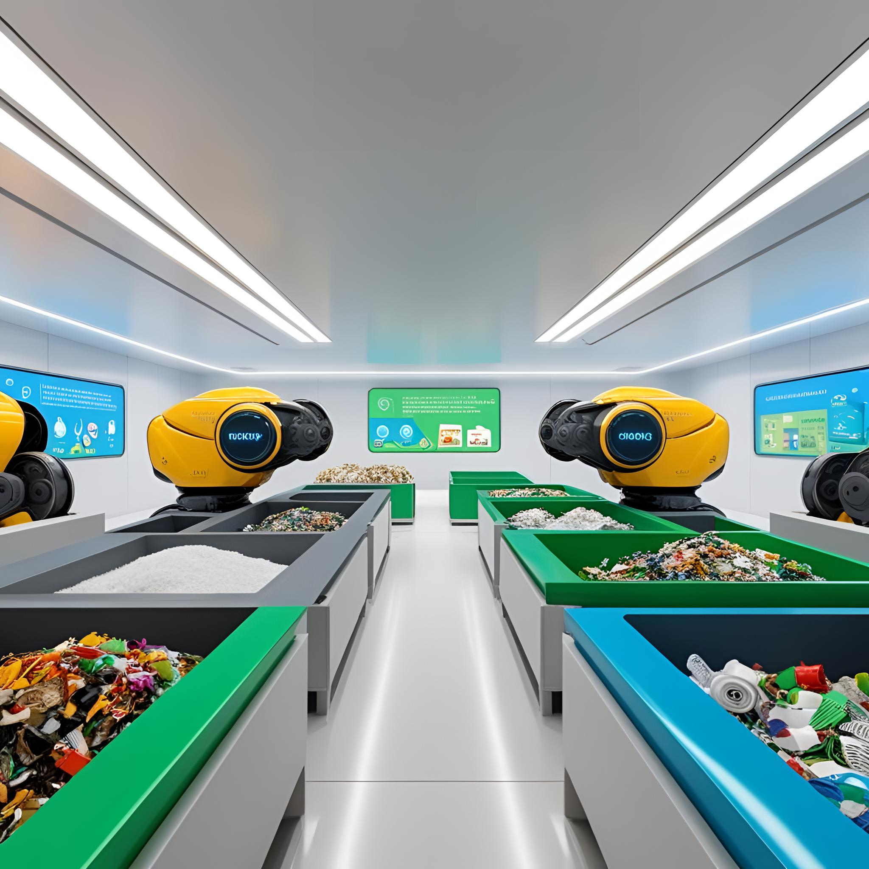
OBJECTIVES
Monitor bin fill levels using IoT sensors
Optimize waste collection routes
Prevent bin overflow and improve hygiene
Promote eco-friendly waste management
Reduce fuel and labor costs

Slide 6
LITERATURE REVIEW
IoT-based Smart Waste Management System for Smart Cities
Smart Waste Management: A Green Approach for Smart Cities
Optimized Waste Collection System Using IoT and Machine Learning
AI-Based Automated Waste Sorting System for Smart Cities
Authors:
S. Bandyopadhyay, S. Chakraborty
Authors:
R. Kumar, P. Sharma
Authors:
D. Singh, A. Arora
Authors:
P. Shreya, M. Sahu
The paper discusses the integration of IoT sensors in waste bins for dynamic waste collection and efficient route optimization, enhancing operational efficiency.
The study explores the role of Big Data and predictive analytics in optimizing waste collection schedules, leading to cost savings and reduced environmental impact.
This paper focuses on machine learning algorithms for predicting waste generation and optimizing waste collection routes, reducing fuel usage and CO2 emissions.
The work focuses on AI-based robots that use image recognition for automating the waste sorting process, improving recycling efficiency.

Slide 7
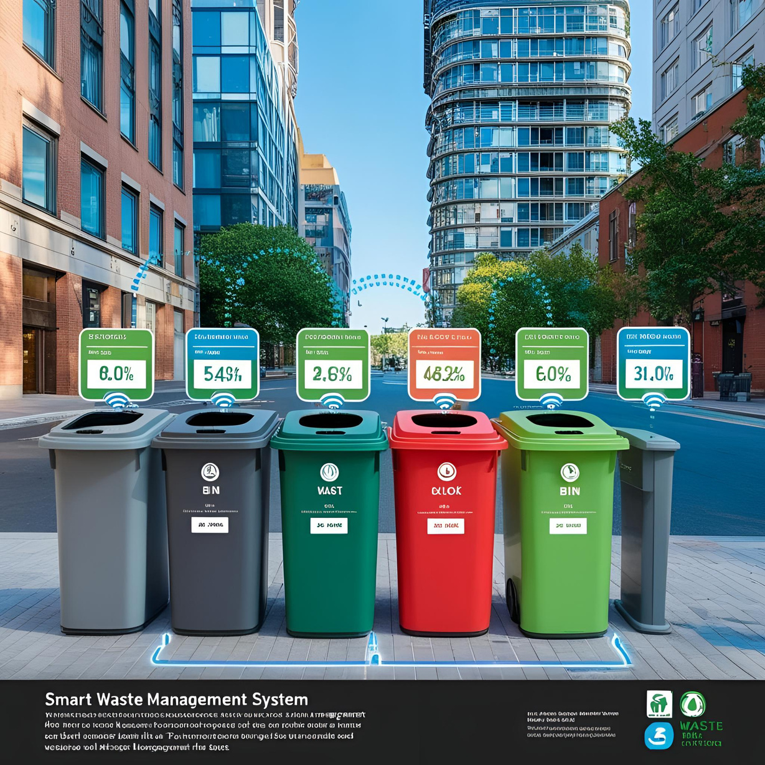
Existing Waste Management System
Traditional waste management relies on fixed collection schedules and manual bin checks, leading to inefficiencies like overflowing bins, unnecessary pickups, wasted resources, and environmental hazards due to the lack of real-time monitoring.
Inefficiencies:
Overflowing bins in high-usage areas
Unnecessary collection from half-filled bins
Wasted fuel and labor due to poorly optimized routes
Environmental & Health Issues
Overflow and delayed collection lead to foul odors, pest infestations, and potential disease spread.
Lack of Real-Time Data
No system in place to monitor or respond to bin fill levels dynamically.
BACK TO AGENDA

Slide 8
PROPOSED SYSTEM
1 | Ultrasonic Sensor: Detects the bin’s fill level.
2 | ESP32 Microcontroller: Collects sensor data and sends it to the cloud.
3 | Wi-Fi/GSM Module: Enables communication between bins and the central system.
4 | Cloud Server: Stores data and hosts the management dashboard.
5 | Mobile & Web App: Used by public users and municipal staff for real-time tracking and management.
6 | GPS Integration: Helps assign the nearest available waste truck.
The proposed system introduces a real-time, sensor-based solution for efficient waste collection using IoT technologies. It replaces static waste pickup schedules with a dynamic, data-driven process.
KEY COMPONENTS

Slide 9
MODULES USED
1. Sensor Module:
2. Cloud/Backend Server Module:
3. Central Control Unit:
4. Monitoring & Dashboard Module:
This module includes ultrasonic sensors placed inside waste bins to measure fill levels. These sensors continuously monitor the height of the waste and send data to the control unit when the bin nears full capacity.
This module stores and processes the data received from multiple bins. It uses algorithms to analyze bin status, generate alerts, and optimize collection routes. It can be built using FastAPI/Flask with MongoDB/Firebase.
The control unit (using ESP8266 or Arduino) receives sensor data and transmits it to the cloud via Wi-Fi or GSM. It acts as the communication bridge between the smart bin and the server, ensuring reliable real-time updates.
A user-friendly web or mobile interface where municipal staff can track bin levels, receive alerts, view route plans, and analyze performance data. Built with HTML, CSS, and JavaScript, the dashboard visualizes data on a map and supports role-based access.

Slide 10
Backend
Frontend
Built with Java Spring Boot
Stores data in MongoDB
Handles:
Sensor data reception (via HTTP/MQTT)
Alert generation
Route optimization
API access for frontend
Developed using Flutter
Provides:
Real-time bin status map
Notifications for full bins
Admin login and dashboard
Analytics and reporting tools

Slide 11
Future Enhancements
Smart Segregation
Solar-Powered Bins
Predictive Maintenance Alerts
Incentivized Public Participation
Use image processing or additional sensors to automatically identify and separate biodegradable, recyclable, and hazardous waste at the bin level.
Incorporate solar panels to power the sensors and ESP32 boards, promoting sustainability and reducing energy dependence.
Use analytics to predict when bins or hardware components might fail and send alerts before breakdowns occur.
Introduce reward-based mechanisms in the app to encourage citizen engagement in waste management (e.g., points for reporting overflows).

Slide 12
REFERENCES
[1] R. Kumar and P. Sharma, "IoT-based Smart Waste Management System for Smart Cities," International Journal of Engineering and Advanced Technology (IJEAT), vol. 8, no. 6, pp. 2442–2447, 2019.
[2] S. Bandyopadhyay and S. Chakraborty, "AI-Based Automated Waste Sorting System for Smart Cities," International Journal of Intelligent Engineering and Systems, vol. 13, no. 1, pp. 23–35, 2020.
[3] D. Singh and A. Arora, "Smart Waste Management: A Green Approach for Smart Cities," Renewable and Sustainable Energy Reviews, vol. 136, p. 110426, 2021.
[4] P. Shreya and M. Sahu, "Optimized Waste Collection System Using IoT and Machine Learning," Materials Today: Proceedings, vol. 47, no. 8, pp. 2322–2328, 2021.

